Slide 1



DEPARTMENT OF ELECTRONICS AND COMMUNICATION ENGINEERING
TITLE :NETWORK ANOMALY DETECTION USING MACHINE LEARNING AND DEEP LEARNING
Under the guidance of
MR.SHAIK NAYAB RASOOL
Assistant Professor
Internal Guide
Presented by
Batch Number:B8
G.SAI TEJA 20EG104207
B.HARSHITHA 20EG204208
B.SHIVA KUMAR 20EG104228

Slide 2

WHAT IS NETWORK ANOMALY DETECTION?
Network anomaly detection identifies unusual or suspicious patterns in network traffic.
Anomalies can indicate potential security breaches, malicious activities, or system malfunctions.
Analysis of network data helps differentiate between normal and abnormal behaviors.
Continuous monitoring involves ongoing analysis of network data in real-time or retrospectively.
Anomalies manifest as deviations from established baselines or predefined norms, such as:
Unusual traffic volume
Unexpected communication patterns
Anomalous packet payloads
Deviations from typical user behavior
Detection techniques range from simple statistical analysis to advanced machine learning and deep learning algorithms.
2

Slide 3
Abstract
In the realm of network anomaly detection, challenges like data imbalance and preprocessing complexities hinder effective security measures. To address this, our project employs innovative methodologies:
Introduction of OSS and SMOTE techniques for handling data imbalance.
Implementation of normalization and matrix conversion to ensure data quality.
Exploration of diverse learning approaches including supervised, unsupervised, and semi-supervised methods.
Utilization of classification algorithms such as logistic regression, decision trees, k-Nearest Neighbour classifier, and Random Forest.
These methodologies offer several advantages:
Enhanced model performance by addressing data imbalance.
Improved analysis and model training through effective data preprocessing.
Increased anomaly detection accuracy achieved by diverse learning approaches.
Enhanced network security measures through accurate classification.
2

Slide 4
INTRODUCTION
Cybersecurity Imperative: Detecting and mitigating network anomalies is crucial in today's digital landscape.
Increasing Complexity: Networks have become more intricate, making them vulnerable to various threats.
Limitations of Traditional Methods: Manual rule-based and signature-based systems are inadequate against evolving threats.
Challenge: Rule-based and signature-based systems often fail to detect novel attack vectors. Challenges include data imbalance, scalability, interpretability, adversarial attacks, and privacy concerns.

Slide 5
OBJECTIVEs
Enhance Detection Accuracy:
Improve accuracy in identifying abnormal patterns and malicious activities.
Achieve higher detection rates and minimize false positives using ML/DL algorithms.
Adaptability to Dynamic Threats:
Enable ML/DL models to adapt to evolving cyber threats.
Continuously learn from new data and detect emerging threats and zero-day attacks.
Scalability and Flexibility:
Ensure scalability and flexibility of anomaly detection systems.
Design modular solutions adaptable to diverse network environments and organizational needs.
Real-world Applicability and Deployment:
Develop practical anomaly detection solutions for real-world security challenges.

Slide 6
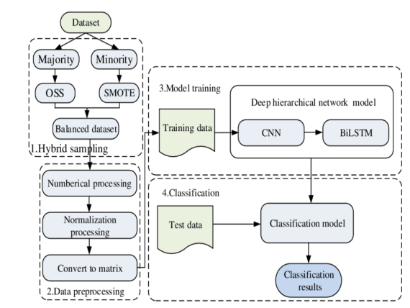
METHODOLOGY(1/5)

Slide 7
METHODOLOGY(2/5)
DataSet:Network sensors capture and monitor network traffic.
Majority Data Set:
Represents the predominant class in a dataset.
Contains data points that are abundant or commonly occurring.
Oversampling with Synthetic Samples (OSS) for Majority Class
Address class imbalance by generating synthetic samples for the majority class.
Minority Data Set:
Represents the less frequent class in a dataset.
Contains data points that are rare or uncommon.
Synthetic Minority Over-sampling Technique (SMOTE)
Counteract class imbalance by synthesizing new instances of the minority class.

Slide 8
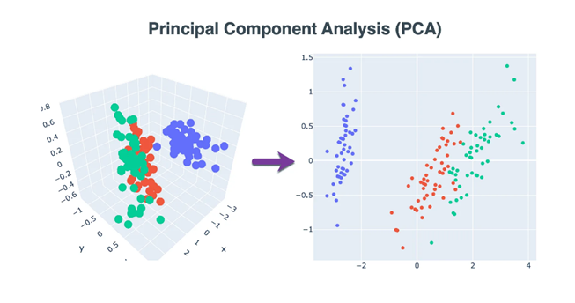
METHODOLOGY(3/5)
Data Preprocessing:
Involves the transformation and preparation of raw data to make it suitable for analysis and model training.
Ensures the quality, consistency, and usability of the data, ultimately influencing the effectiveness and reliability of the anomaly detection model.
Numerical Processing:
Involves handling numerical features within the dataset.
Normalization preprocessing
Technique used to rescale numerical data to a common range, typically between 0 and 1,
to ensure that different features contribute equally to the analysis.
Conversion into a Matrix
To prepare numerical data for input into machine learning algorithms or neural networks, it is converted into matrix form. This involves organizing the numerical data into a matrix structure, where each row represents a data point, and each column represents a feature.

Slide 9
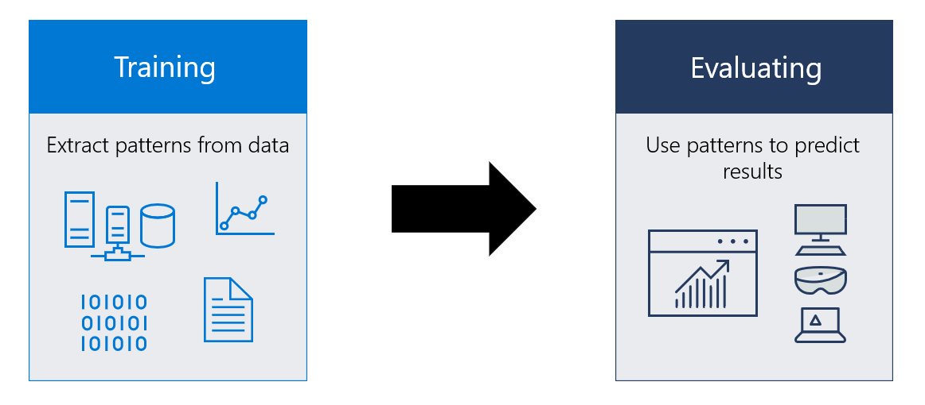
METHODOLOGY(4/5)
Model training:
Fundamental aspect of building effective anomaly detection systems.
Critical for performance and accuracy in real-world scenarios.
Algorithm Selection:
Choose appropriate algorithm based on dataset characteristics and anomaly nature.
Options include supervised, unsupervised, and semi-supervised learning.
Supervised Learning:
Requires labeled data with normal and anomalous instances.
Examples: Support Vector Machines (SVM), Random Forests.
Unsupervised Learning:
Doesn't need labeled data; identifies anomalies based on deviations from normal behavior.
Examples: k-means clustering, Isolation Forests.
Semi-Supervised Learning:
Blend of supervised and unsupervised; suitable for partially labeled data.

Slide 10

METHODOLOGY(5/5)
Classification:
Train model to predict classes accurately.
Importance: Vital in anomaly detection.
Data Acquisition: Obtain labeled data.
Model Training: Adjust parameters to minimize loss.
Algorithms:
Logistic regression
decision trees.
k-Nearest Neighbour classifier
Random Forest:
Evaluation: Assess performance on separate data.

Slide 11
SOFTWARE REQUIREMENT
Python:Python is a high-level, versatile, and open-source programming language that has gained immense popularity for its simplicity and readability.
Google Colab:Google Colab, is a powerful and user-friendly cloud-based platform designed for coding, data analysis, and machine learning using the Python programming language.
LIBRARIES USED:
Pandas: Python library for data manipulation and analysis using DataFrames and Series.
Warnings: Python module for controlling warning messages in code.
Matplotlib: Python plotting library for creating various types of visualizations.
Logistic Regression: Linear classification algorithm for modeling binary outcomes.
K Neighbors Classifier: Intuitive classification algorithm based on nearest neighbors.
Decision Tree Classifier: Versatile algorithm for classification tasks, based on splitting feature space.
Robust Scaler: Preprocessing technique for scaling numerical features, robust to outliers.
Random Forest Classifier: Ensemble learning method combining multiple decision trees.
SVM (Support Vector Machine): Powerful supervised learning algorithm for classification and regression.

Slide 12
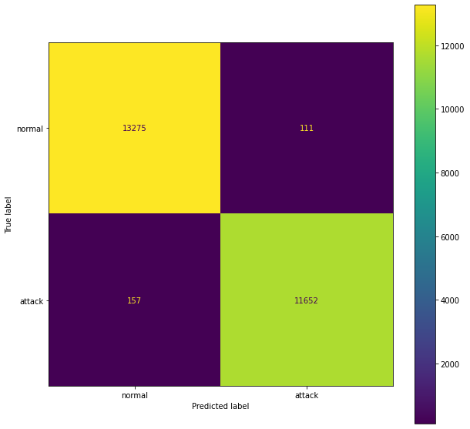
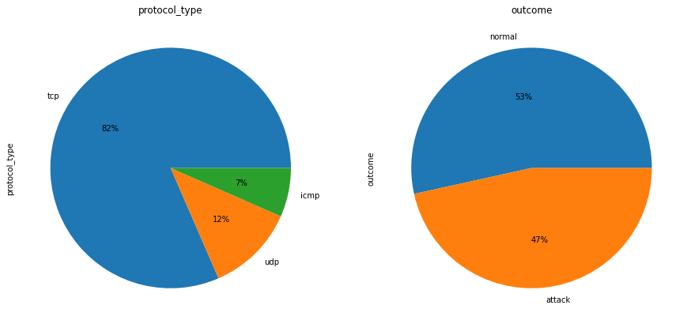
RESULTS(1/4)
The output of data processing is shown below:
Collects the raw dataset and classifies them according to the type
Of network .
The output for model training is it shows a graph of test accuracy and training accuracy for each classification model. For KNN the output is :
The testing accuracy is 98.93% and the training accuracy is 99.03%.

Slide 13
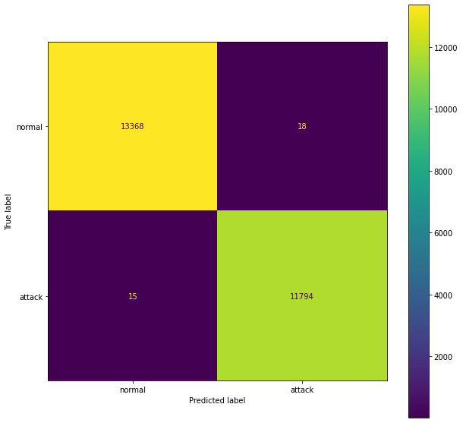
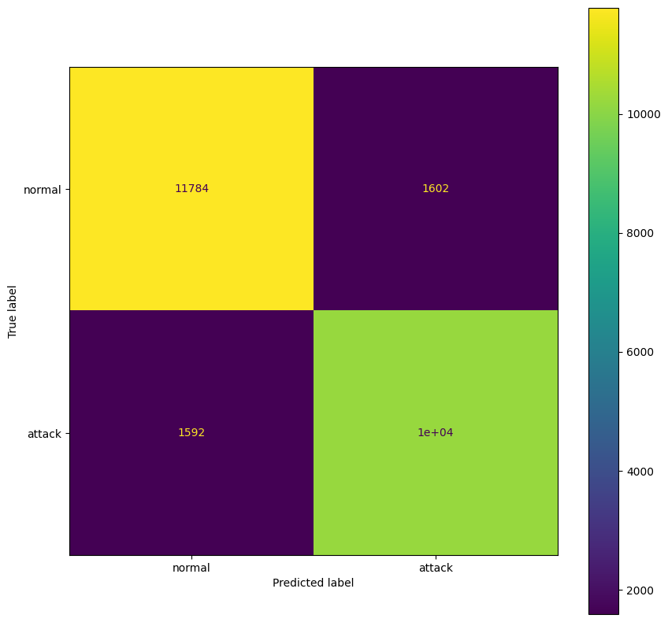
RESULTS(2/4)
For Decision Tree Classifier the output is:
The testing accuracy is 99.86% and
the training accuracy is 99.99%.
REFERENCES
Training Accuracy Logistic Regression 87.49417029679391 Test Accuracy Logistic Regression 87.32288152411193

Slide 14
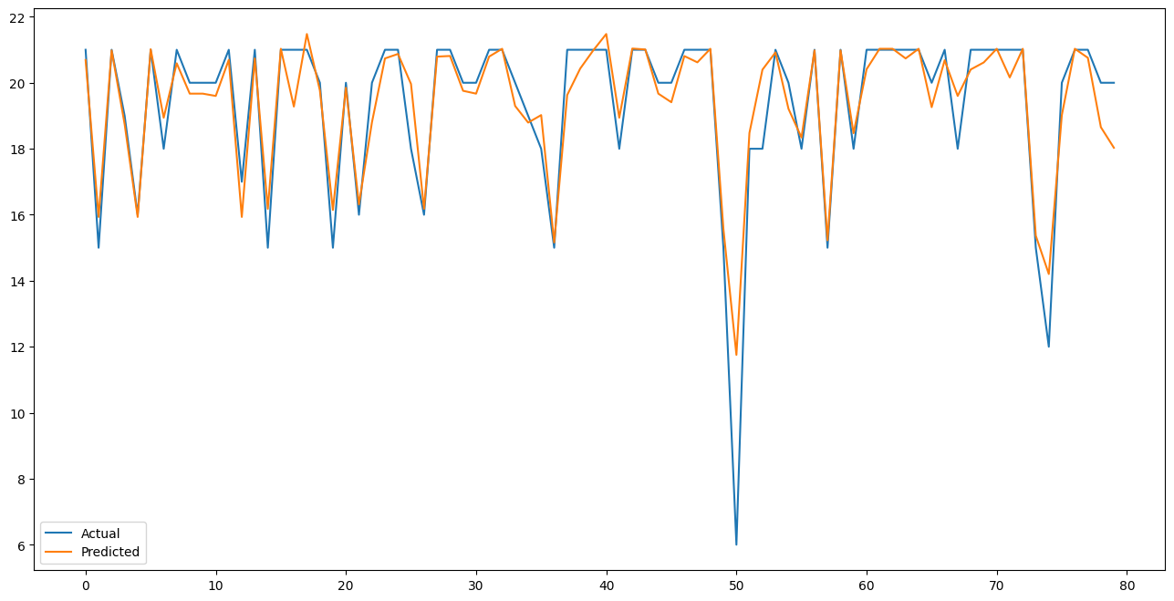
RESULTS(3/4)
Training Error XGBOOST 0.9286577828406372 Test error XGBOOST 0.9955133892384386
Training Error XGBOOST 0.9286577828406372 Test error XGBOOST 0.9955133892384386
The output waveforms using XGBOOST are a precession recall curves (PR) separating actual network indicated with blue line vs predicted network indicated with red line
Training Error XGBOOST 0.9286577828406372
Test error XGBOOST 0.9955133892384386
REFERENCES

Slide 15
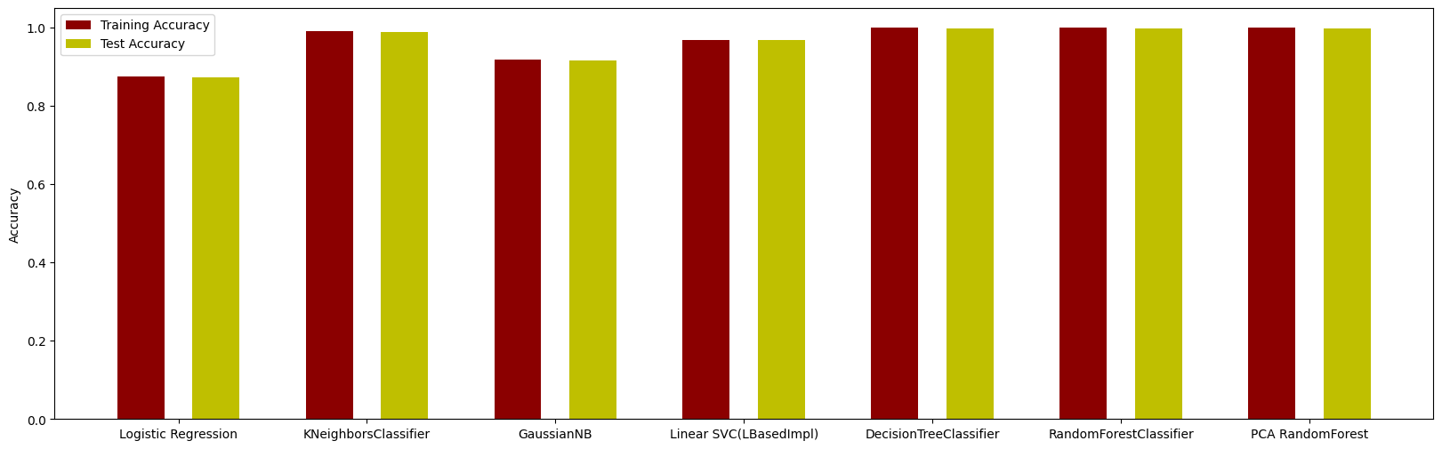
RESULTS(4/4)
Training Error XGBOOST 0.9286577828406372 Test error XGBOOST 0.9955133892384386
Comparison of test accuracy and training accuracy of various classifier models used
The classifier model having highest training accuracy and test accuracy is decision tree model classifier model with the testing accuracy is 99.86% and the training accuracy is 99.99%.The classifier model having lowest training accuracy an test accuracy is Logistic Regression classifier model with the testing accuracy is 87.62% and the training accuracy is 87.97%.
REFERENCES

Slide 16
FUTURESCOPE
Advancements in Machine Learning and AI:
Explore deep learning architectures beyond CNNs (e.g., RNNs, transformer models) for better pattern recognition in network traffic data.
Integration of Anomaly Detection Methods:
Combine anomaly detection with signature-based and behavior-based approaches to identify unseen threats and zero-day attacks.
Adaptive IDS Techniques:
Utilize anomaly detection, outlier analysis, and clustering to dynamically adapt to evolving threat landscapes.
Proactive Threat Mitigation:
Enhance IDS capabilities to proactively mitigate emerging cyber threats.

Slide 17
REFERENCES
[1] Aazam, M., Huh, E.-N., & Ghani, A. (2020). A Survey on Intrusion Detection in Fog Computing Environments. (International Conference on Information Networking (ICOIN)) Bhadade, N., Patil, A., & Pujari, S.S. (2020). A Survey on Network Anomaly Detection Techniques. (International Conference on Pervasive Computing and Communications (PerCom))
[2]Chakraborty, S., Islam, I., & Rahman, M.S. (2012). Network Traffic Anomaly Detection Using Machine Learning Techniques. (15th International Conference on Computer and Information Technology (ICCIT))
[3]Chandrasekaran, V., Sivaprakasam, M., & Jawahar, C. (2017). Anomaly Detection in Network Traffic Data Using Isolation Forest. (International Conference on Intelligent Systems and Control (ISCO))
[4]Giao, T.N., Hua, B.S., Phung, D.T., & Phung, Q.V. (2019). A Comprehensive Survey on Network Traffic Classification. (IEEE Communications Surveys and Tutorials)
[5]Liu, J., Chen, C., Jin, C., & Zhou, J. (2019). Semi-supervised Network Anomaly Detection with Graph Convolutional Networks. (IEEE Transactions on Knowledge and Data Engineering)

Slide 18
THANK YOU

